Slide 2
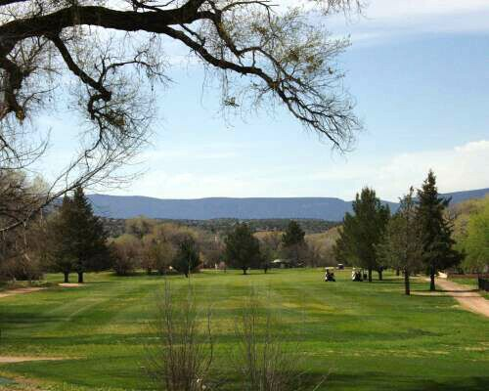
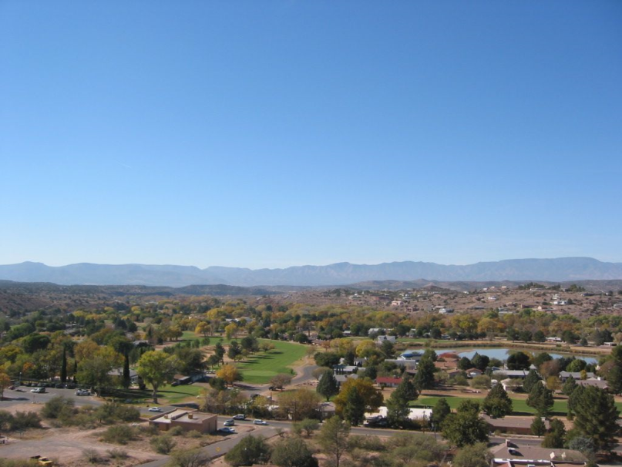
THE MISSION
Establish a member owned facility providing:
          JOBS
          ECONOMIC STABILITY
          SECURED COMMUNITY OPEN SPACE
Return the Beaver Creek Golf Course and the Ranch House Restaurant complex to full operational status.

Slide 3
Ranch House Coalition Activities
The Ranch House Coalition – RHC – is a membership organization whose main focus is the preservation of the Ranch House restaurant and golf course in Lake Montezuma.
It is a committee (or project) of the Beaver Creek Community Development Corporation. The Core Action Team – CAT – is a team of volunteered professionals putting together the parts to fulfill specific objectives of RHC. In relation to the restaurant and golf course, CAT has:
Presented 2 commercial lease / purchase offers;
Developed business & marketing plans;
Recruited restaurant management & personnel teams
Designed and developed Coalition marketing materials – website – banners – information cards;
Developed restaurant operational budgets, ratios & margins;
Market Analysis - national & regional golf club industry & real estate sales

Slide 4
Ranch House Coalition Offer to Purchase
Dated: June 15, 2010 - Owner: Beaver Creek Golf Resort, LLC
Buyer: Beaver Creek Community Development Corporation - Ranch House Coalition
Subject Property:
Beaver Creek Golf Course property- Tracts M through T, roughly 103 acres,
Assessor Tax Parcel 405-01-020X (56.54 acres – minus Final Platt residential lots) and
Assessor Tax Parcel 405-01-022H (64.38 acres – minus Final Platt residential lots) and Restaurant / Clubhouse property Tract G, 3.84 acres,
Assessor Tax Parcel 405-57-091
These tracts and acreage identified corresponds to the golf course as part of the PAD minus the acreage for the 137 condo lots.
Offer Price:
$500,000 with owner carry
Terms: Open Escrow- $5,000 / Total at Close of Escrow: $25,000 Due 60 days.
Secured by Promissory Note at 9.75% interest amortized over 20 years with balloon at 36 months, with no pre-payment penalty. Pre-payment of principle amount not subject to interest
Subject To:
2300 acre feet of water rights sufficient to irrigate the golf course and restaurant acreage and maintain lake water levels.
ASSUMPTION OF TOTAL DELINQUENT TAX BURDEN = $78,322.68

Slide 5
Pros Recommend Fixer Uppers
In 2010 I believe many fixer-uppers can now be highly profitable, because prices for these golf courses have come down significantly - some up to 75%. (Update: I'm seeing golf courses available for less than $1.5 million worth close o $3.5 million only 3 years ago.)
NOTE: COURSE CLOSINGS MEAN BETTER OPPORTUNITIES: It's been reported there was a net drop in golf courses in the USA in 2007 and 2008. Closed golf courses release rounds of play - a benefit to those still in business. I predict many more.
Buying a golf course now, while prices are still down
could be a good decision.
No longer money pits! Now they can be opportunities!
If you can buy right, fixer-upper golf course can be opportunities. Many run down golf courses can be acquired for as little as 20 cents on the dollar. Some can be bought for less than 1/2 their appraised value of just a few years ago.

Slide 6
The Sale Price
The last recommendation of the CORE ACTION TEAM of RHC (the Coalition) is that the property” as is” – is only worth about the $500,000 the Coalition offered, but suggests an appraisal would be in order.
The owners of the property rejected a 20 year lease purchase offer submitted by the Coalition in April for the restaurant only.
A $580,000.00 purchase offer submitted by the Coalition in June for the restaurant and the golf course was also rejected. – Most likely because the owner’s other obligations exceeding the amounts offered and the fact that they were not CASH offers.
An acceptable sale price expressed by the owners is between $1.2 and $1.7 million – in “as is” condition.
Efforts should continue to convince the seller to lower the price, however, financial & economic conditions motivates them to get as much out of this property as possible.

Slide 7
Who would buy this property?
Whatever the purchase price, an additional $500,000 - $1.0 million worth of labor and material is required to make the restaurant AND course operational. Now, with these totals, let’s say - $1.7 to $2.7 million invested in a golf course & clubhouse – it can only make economic sense to:
Real estate development entities planning for further develop the property (e.g., condominiums, hotels, commercial sales ) in order to realize any meaningful DOLLAR return on their investment.
– OR –
A community or property owner’s organization protecting their recreational areas in order to realize a SOCIAL return on their investment and securing property values.

Slide 8
COMPARE GOLF COURSES FOR SALE:
Ironwood Golf Course - Georgia
A Million Dollar Golf Course
Seller Financing Offered
Beautiful 18-Hole 6875-Yard Championship Layout
Excellent Condition
Fully Irrigated
Cart Paths All the Way
Excellent practice range (see disclosure notes)
Easy-to-Manage
Separate Clubhouse Grill with Fully Equipped Kitchen
New Maintenance and Cart Buildings
Controlled Overhead
An Excellent Owner-operator Opportunity
Scroll down this page to view pictures.
Link to more pictures
Link to my professional analysis

Slide 13
Compare with…

Slide 14
Compare with…

Slide 15
Compare with…

Slide 16
Compare with…

Slide 17
Iowa Golf Course Not Disclosed, IA, USA $579,000
Well established 36 par course on 60 acres. Spring-fed pond & creek are the water hazards. Includes land, clubhouse, cart barns, fixture, equipment & training.
Compare with…
Missouri Golf Course Not Disclosed, MO, USA $250,000
Nine hole golf course located in Bethany, Missouri at intersection of Highways 136, 69 and 13. This 34.8 acre golf course has been in business for over the past 40 years. It has all irrigated grass greens and 5 ponds. There is an 80' x 24' combination club house/entertainment center, a 30' x 120' cart shed, a 30' x 90' cart shed, an 11' x 56' cart shed, and a 42' x 48' workshop.
LOUISIANA COURSE - Price - $1,850,000
The Northwood Hills Country Club is located in Shreveport, LA, and offers an 18 hole golf course, Clubhouse, 167 acres, Pro Shop, Fitness Center, Pool and Pool House, parking for 300 cars, and a 2 Bedroom Apartment.
Golf Course & Country Club OK, USA Asking Price: $1,200,000
18 hole championship course on 155 acres. Club house with restaurant & bar. It is one of the finest courses in the 4 state area. Potential for developing a gated community.

Slide 18
Compare with…
Golf Course For Sale in Illinois / IL The Perfect One Day Getaway Golf Course for Sale Price: $1,750,000 - 18 hole, par 72 course established in the 1960's. Members club & public course. 5,400 square feet course house, pool and pool house. Storage sheds for 200 plus golf carts. On 145 acres.
18 Hole Golf Course Not disclosed, WA Asking Price: $1,400,000
Property features an 18 hole golf course, 16 room motel, full service restaurant, lounge, club house & meeting room. All equipment involved in taking care of the golf course is included. There are 3 cart barns, of which 1 is for electric carts & 2 are for gas carts. All sitting on approximately 95 acres of land, some of which can still be developed into lots or perhaps condos.

Slide 19

Compare with…
Golf Course For Sale in Ohio / OH - Private Golf Course With Pro-Shop and Club House Price: $1,500,000
Private golf course for sale. In addition to course, there is a clubhouse, pro shop and adjacent maintenance facilities. This unique eighteen (18) hole course is designed with tree-lined fairways, rolling hills, and offers an incredible scenic view. Fine and casual dining, banquet and party services, and overnight lodging are all offered by this course. Liquor license and full complement of mowing, landscaping and maintenance equipment are also included with purchase.

Slide 20
So, What are our OPTIONS?
ACT:
Develop a self-sustaining plan. - Acquire the property (albeit at a high price) & Open the restaurant & golf course.
– OR –
DO NOTHING:
Allow the golf course owners a 6 to 12 month leeway to sell the property for development and live with its future condo & hotel plan (which may be 5 – 20 years in the making)
–OR –
WAIT:
Wait things out to see if the owner’s situation worsens, further complicated by bankruptcy (which could eventually lower the selling price).

Slide 21
Approaches

Slide 22
Sale of Private Investment Bonds
FINANCING through bond issues is usually considered a governmental or business fund-raising technique.
In certain instances, however, a small, private bond issue offered only to residents can be a practical way for cooperatives, condominiums and homeowner associations to raise money for capital improvements.
It can be an alternative to reserve-fund withdrawals, traditional bank financing or special assessments.
The bond issue can prove less expensive to the housing association than conventional financing, while resident bondholders may regard receiving interest income far more favorably than having to lay out cash in a special assessment.

Slide 23
Private Investment Bonds
No public solicitation is allowed, and the maximum sum is limited to $500,000. The funds thus raised must be used for a specific purpose, outlined in advance.
The structure for an issue sold to area families and households can be notes of $500 - $1,000 each, with terms of 10-year at a high yield, repayable in equal annual installments.
This type of bond financing is allowed under Rule 504 of Regulation D of the Securities and Exchange Commission. The paperwork needed for this type of offering is the ''least onerous'' of any bond issue. The aim is to raise capital from a small, private group of people already known to one another without having to go through the full disclosure and registration required of a public offering.

Slide 24
Private Investment Bonds
As with a conventional fixed-rate mortgage, interest makes up most of the payment in the early years, with principal increasing as the bond is repaid.
The interest is normally subject to state and Federal income tax, where applicable. The attraction of the bonds lies in the fact that their rate is higher than current bank money-market funds.
The issuer must supply detailed assurances concerning repayment capabilities. This can be collateralized by a tangible asset, such as a lien on the common property.
Arrangements can also be made to assure buyers that the association would buy back the bond any time, at current value, should the buyer need his capital.
A bondholder who moves may not sell or transfer his bond to his buyer, but he may sell it back to the association, which may in turn offer it to the new resident.

Slide 25
Private Investment Bonds
Attention needs to be given against such possible abuses as letting resident buyers vote themselves an excessive interest rate or letting residents vote on the innovative financing, even though a board may have the legal right to make an independent decision.
As with conventional financing, a long-range plan is needed to provide for repaying the bonds with interest, and state and Federal regulations on private bond issues must be met. Since regulations do not permit trading or reselling such bonds, the action to take if a bondholder needs repayment before maturity should be decided in advance.
Federal law sets no limit on the Tom Bloom number of purchasers. But buyers must be ''members,'' a somewhat vague term meaning that participation must be limited to people already familiar with the particular circumstances. In the case of the Ranch House Coalition or homeowners' association, it would be wise to limit buyers to members only.

Slide 26
Ranch House Coalition
Bank Business Loan w/
Loan Guarantee
The USDA has a program – whereby they guarantee bank loans to businesses in rural areas.
The average project size in AZ is $1.5 million with USDA guaranteeing 80% of the deal.
Medium and smaller banks generally participate in the guarantee program.
There has been a steady increase in government guarantee loans throughout our state in large part to the economic condition.
The guarantee application and packaging is done by the bank. Qualifications include businesses with strong equity and collateral. While this project (restaurant & golf course) may have the collateral (land), the purchase price will determine the amount of real and potential equity.

Slide 27
Ranch House Coalition
Bank Business Loan with Loan Guarantee
The strength of the business revenues must cover its operating costs in addition to the debt service.:
The debt service on a typical 25 year $2.0 million loan at 6% is $12,900 per month.
The debt service on a typical 20 year $1.5 million loan at 6% is $10,700 per month.
The affordable monthly debt service for the restaurant is limited to approximately $4,200 at optimum conditions.
An estimated debt service for a functioning golf course in our area would not exceed $4,000.
The potential revenue available to service such a loan is estimated at $8,200 per month at optimum performance.
An appraisal is necessary for financing purposes. Federal law dictates that banks must order the appraisal - not the borrower. From research on appraisal formulas for golf courses, it is doubtful that the appraised value would come close to the asking price. The value of this property as golf course and club house may appraise under $500,000.

Slide 28
Bank Financing with Loan Guarantee &
Voluntary Assessment
60% Beaver Creek Community Participation – 25 Years

Slide 29
Bank Financing with Loan Guarantee & Voluntary Assessment
30% of Beaver Creek Community Participation – 20 Years

Slide 30
Bank Financing – with Loan Guarantee & Voluntary Assessment
Lake Montezuma Property Owners only – 20 Years

Slide 31

Grants
Grants are few and far between, however there are some economic development and preservation grant sources available:
USDA sponsors Rural Business Enterprise Grant (RBEG) that support rural economic development projects that assist specific small & emerging private businesses. The typical assistant amount is $100,000 granted to nonprofit economic development groups, tribes and public bodies. This year’s allocation for Arizona is $522,000. Applications for year 2011 awards are due between December and February
Private corporations & public foundations such as American Express, APS, Yavapai County & Arizona Community Foundation, Arizona Heritage Funds, etc. are available – BUT are primarily project specific. Where the purchase of land and building may not qualify, projects such as heritage & cultural preservation, youth and elderly programs, elderly / affordable housing development or other activities that can take place on the property would qualify.
A 501c3 tax exempt designation is necessary for the applying organization.

Slide 32

Special Improvement Districts
County Improvement Districts (CIDs) are created by the Board of Supervisors for the purpose of making street, sewer, or other local improvements, and for the acquisition and operation of a community center, park, or recreational area.
The Board of Supervisors sits as the managing board of the district.

Slide 33
County Improvement District as provided for and outlined in ARS§48-909(A)(10):
The acquisition, in the name of the district, by gift, purchase or otherwise and the maintenance, repair, improvement or disposal of any real or personal property necessary or convenient for district operation for a community center, park or recreational area.
A county improvement district formed for this purpose would be able to go to bond in order to purchase and improve the golf course facilities.

Slide 34
What is an Improvement District?
Improvement districts give communities outside of municipal boundaries the opportunity to purchase, condemn, construct or repair properties and systems with a combined financial effort.
A district establishes an authority that is responsible for these improvements. Decisions are made locally and in open meetings to allow public input and notification to property owners of the status of the district’s operation.
Inter-Governmental Improvement districts can assess properties and impose taxes to allow for equal financial contributions from properties receiving a benefit from the improvement.

Slide 35
What Can Improvement Districts Do?
Improvement districts have the authority to assess properties and impose ad valorem property taxes to distribute the cost of improvements among the properties benefited. (The county collects taxes on behalf of the district in a similar manner as property taxes.)
As decisions are made in open meetings the residents have the opportunity to be heard on issues concerning the system and the district.
An improvement district is considered a political subdivision of the State of Arizona, which is a governmental agency and cannot profit.
Fees charged shall cover the cost to construct, repair and operate the improvement.
Improvement districts do not pay property or income tax. They are, however, required to pay sales tax on purchases.

Slide 36
How are Improvement Districts Funded?
An improvement district can conduct a bond sale or acquire State and/or Federal funding. Property assessments and system revenues are ways to repay these types of funding.
Typically a district charges a monthly or quarterly user fee. These fees can cover the cost for administration, operation, and maintenance of the improvement. Most districts also have the authority to impose an ad valorem tax to cover costs not recovered in user fees.
The fees charged to the properties benefited by the improvement cover the financing of a district. It is the responsibility of the Board of Directors to establish these fees, but it is the obligation of the users of the system to pay for the construction and operations of the improvements

Slide 37
Net Assessed Values for Beaver Creek Fire District
Below are previous year’s Net Assessed Values (NAV) for the Montezuma/Rimrock Fire District. The NAV report is finalized in February each year.
These values are used by all Beaver Creek districts to set tax rates.
Final values for 2011 is approximately $51,584,431. Exemptions, appeal, or tax court cases for the 2011 tax year not yet completed.
$43,824,811
$60,254,331
$64,517,600
$57,621,462
$51,584,431 - Estimate

Slide 38
Special Improvement Districts Process
Legal descriptions submitted for creation of new districts shall be stamped or signed as sufficient and meeting statutory requirements with regard to contiguity by a registered professional engineer, registered surveyor, or other person similarly qualified to write and attest to the accuracy of a legal descript
This means that we have to draw boundaries using legal descriptions – engineering / surveyor costs involved unless we have someone who would donate their services.

Slide 39
Special Improvement District Process
(2) Bond amounts for the creation of county improvement districts shall include all costs to the County in the event the district is not established. Bond submitted in the form of a personal check, whether on the account of an individual or an organization, shall be cashed upon receipt.
This means we will have to put up some cash (bond) to cover the county’s costs. County costs includes mailing & postage, publishing, staff time, verification, and other County administrative cost. This is estimated at around $5,000.

Slide 40
Special Improvement District Process
(3) Verification of petitions for establishment of districts pursuant to A.R.S. §48-261 shall be accomplished in accordance with A.R.S. §48-265 and §48-266. The determination of the Assessor and the Recorder as to the sufficiency of the signatures shall be the County’s official and final determination with regard to whether the petitions meet statutory requirements.
60% of the properties within a proposed boundary will be required. This would mean that we would need a MASSIVE petition drive to form the district.

Slide 41
Special Improvement District Process
4) Verification of boundary change petitions for districts established pursuant to A.R.S. §48-261 shall be accomplished in accordance with §48-265 and §48-266. The determination of the Assessor and the Recorder as to the sufficiency of signatures shall be the County’s official and final determination with regard to whether the petitions meet statutory requirements.
Several boundaries should be explored that may include all Lake Montezuma subdivisions aligning the golf course, the balance of Lake Montezuma subdivisions, other Beaver Creek communities.

Slide 42
The Downside to Improvement Districts
While an improvement district may be an extremely viable funding alternative, there are some concerns that needs to be considered:
1. Although Yavapai County officials and the owners of the golf course have recommended this option as a finance source for the property, it may not be well timed as it would be viewed as an additional “TAX” on an already burdened community.
2. Improvement districts are not quick fix solutions, as it may take upwards from 1 to 3 years to establish.

Slide 43
Improvement District Community Center - ???
Broad base support of the overall Beaver Creek communities would mean the project would need to meet broad based community needs. A restaurant and golf course may not meet a broad base community need.
Arguments could be made for a multi-purpose recreation center or a community center as meeting a broad base community need. However, the location of this type of facility in the Lake Montezuma area – specifically on the golf course property, may meet with various objections:
The property is not centrally located in the community;
Increased traffic in the neighborhood may be cause problems with adjoining property owners;
Rezoning would be necessary as it is not part of the current Villas at Beaver Creek sub-division PAD zoning;

Slide 44
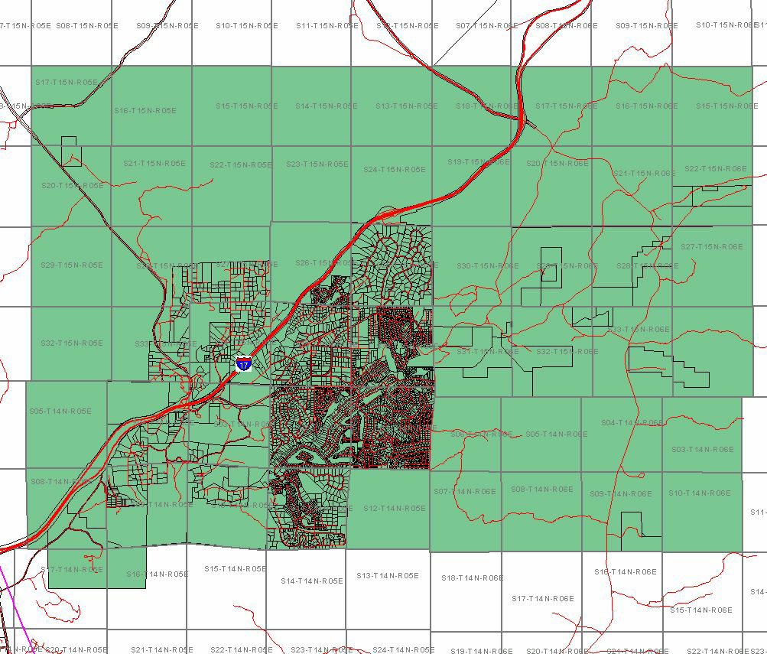
The Beaver Creek Community
Montezuma / Rimrock Fire District

Slide 45
Beaver Creek Property Ownership – Special District Alternatives

Slide 46
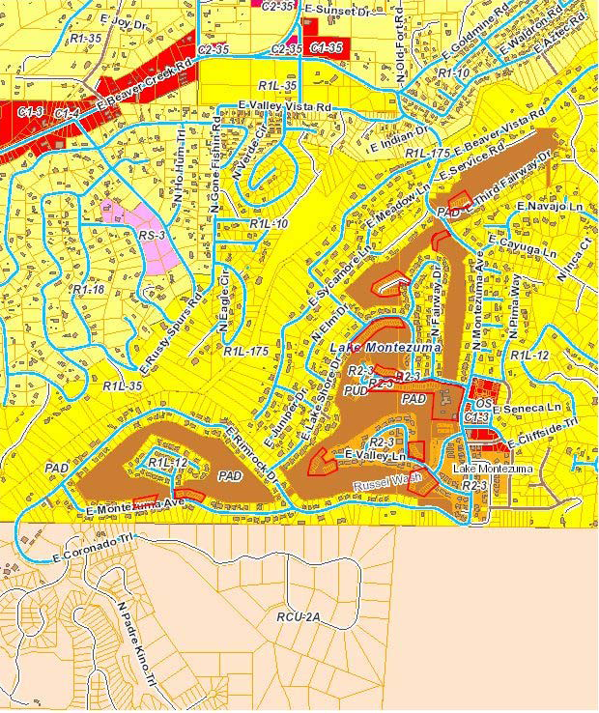
Lake Montezuma – Golf Course Properties
Villas at Beaver Creek Subdivision - Condos
Golf Course
Beaver Creek Ranch Estates Subdivision
A William / Shabatka Development
New Indian Lakes Subdivision

Slide 47
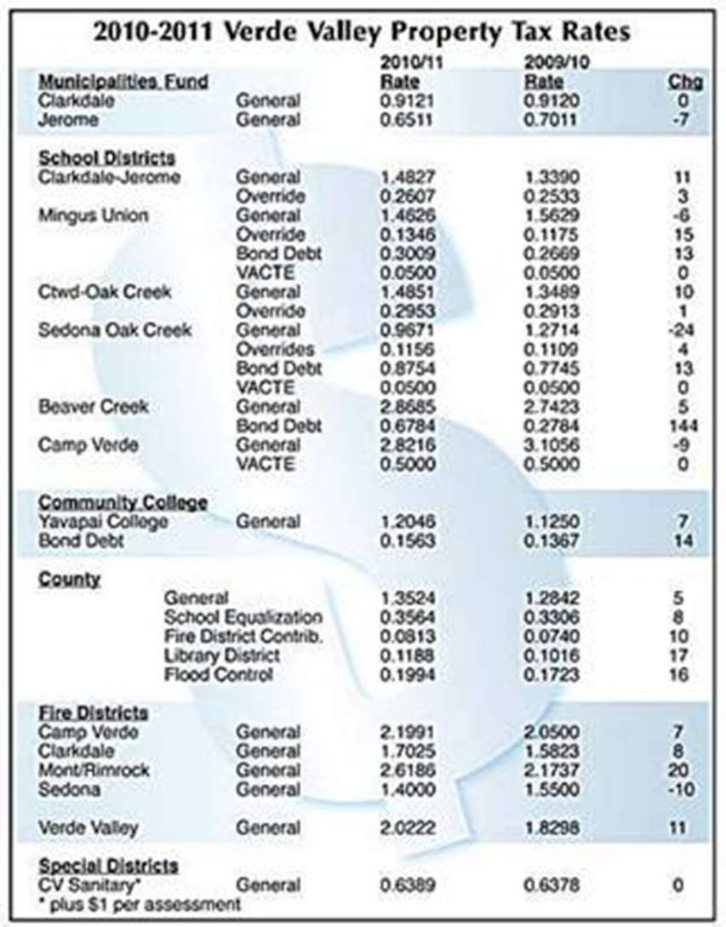
A look at area PROPERTY TAX & ASSESSMENTS

Slide 49
Challenges to Finance Options
Traditional or guarantee bank loans may be difficult to obtain due to the unprofitable golf course, general high risk of restaurants, no business equity, and over-valued collateral.
While issuance of private bonds is a reasonable and voluntary form of financing, the issue is limited to $500,000 – which is about a third of the estimated property list price in its “as is” condition. Grants are project specific and may not be available or in sufficient quantities for golf course property purchase.
Improvement districts are equitable means of financing however takes multiple years to develop and known to divide communities. The larger the district - the more petition signatures needed – the more difficult to form.
Business revenue and assessments (tax) need to sufficiently cover the debt service of any financing package - exclusive of grants. Optimum projected sales & revenues of a restaurant and golf course indicate s approximately $8,200 per month available for debt service.

Slide 50
Options for Consideration
An optimum plan could be the development of a comprehensive time phased package that includes each of the finance options and all stakeholders with the maximum direct benefit to the Lake Montezuma and surrounding communities. For example,
Developers, banks & asset lenders holding golf course condo lots provide low interest, interest only &/or differed interest loans totaling $500 – to $1.0 million towards golf course purchase & restoration.
--AND- -
Combine USDA rural guarantee bank loan with private investor/developer finance package for the golf course property purchase for approx. $750K to $1.0 million.
--AND- -
Ranch House Coalition membership purchase private placement bonds for restaurant at approx. $400 - $500K.

Slide 51
Options for Consideration
Implement a voluntary – barn raising effort to rebuild & restore the restaurant and course to standard code.
--AND- -
Form a Lake Montezuma improvement district for golf course & public improvements, equipment and maintenance,
--AND- -
Coalition investments in senior or assisted living units, golf sales & services, etc. generating additional revenue.
--AND- -
Apply for grants to assist with after purchase marketing and preservation efforts.

Slide 52

WHERE TO DO WE GO FROM HERE?
A community financing package for the Ranch House Restaurant and Beaver Creek Golf Course is possible. However, it takes a large team of neighbors and volunteers or full time experts to pull together.
Are you up to the task?

